Slide 1
Caraway
Group 7
Ada Pici, Charlotte Andry, Hina Khalid, Safiya Mustafa

Slide 2
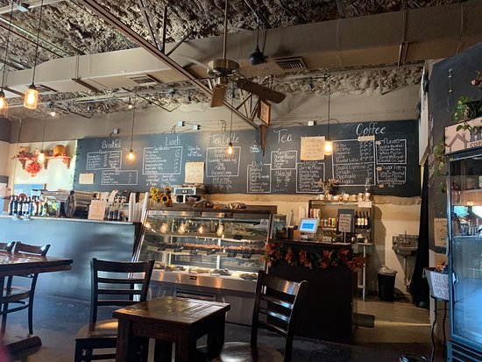




Stress Meter
Notes:
Jaleesa Graham is a junior at at UIC, currently she is working part time at a local coffee shop while being a full time student.

Slide 3
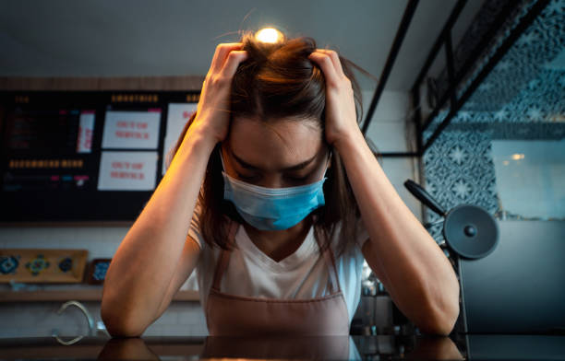
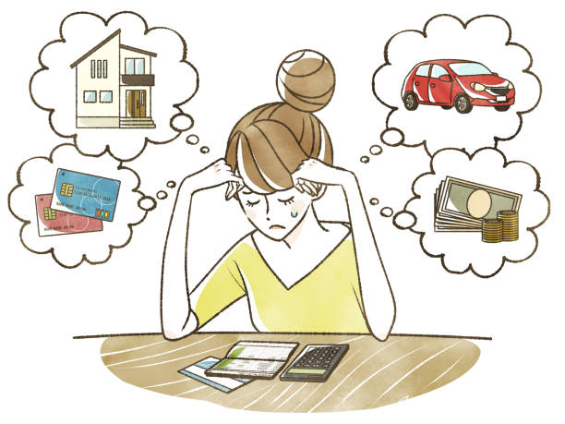
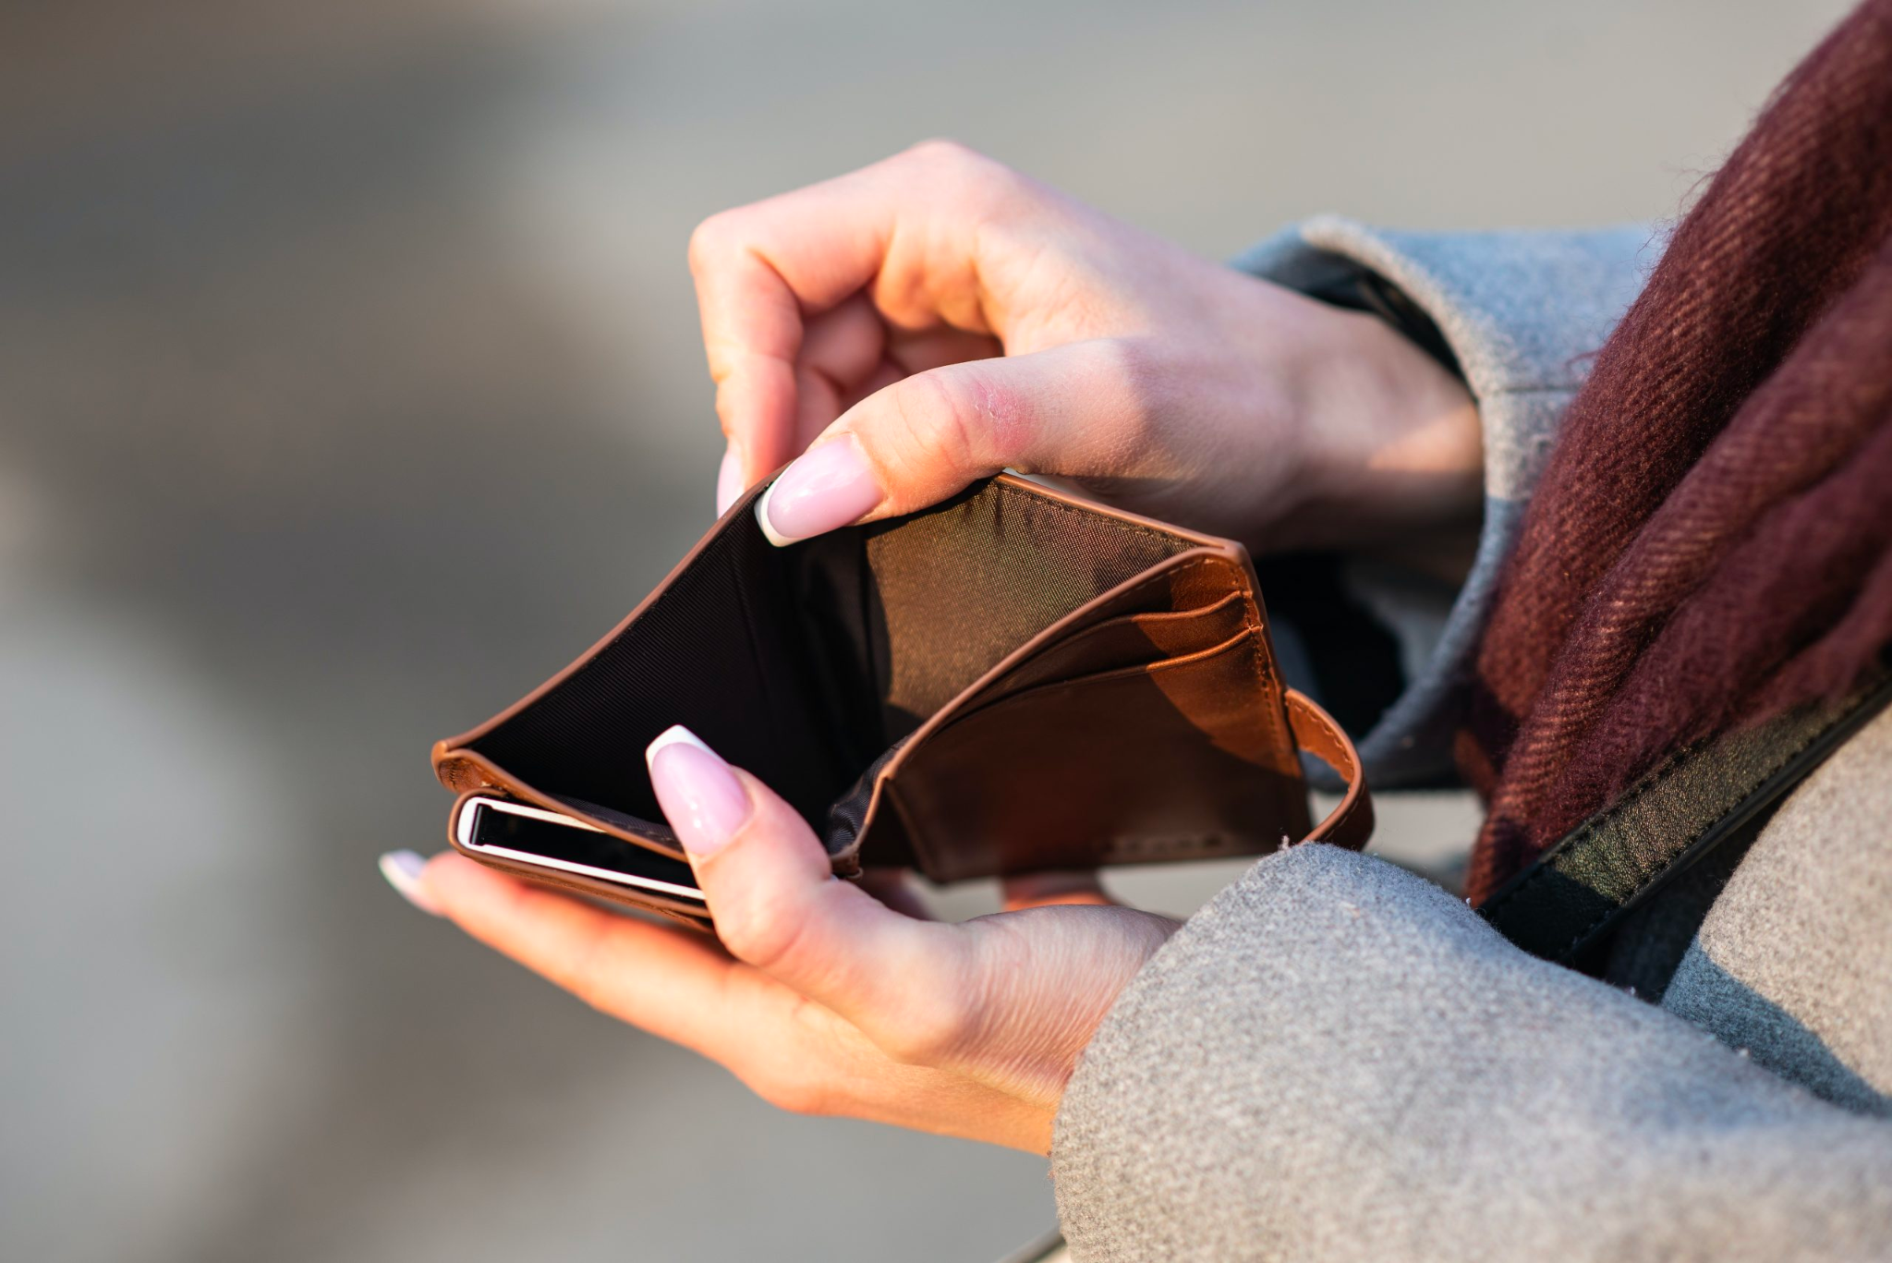
Notes:
Recently, she’s felt stressed as her family is having financial difficulties and she has needed to work longer hours at the store.

Slide 4
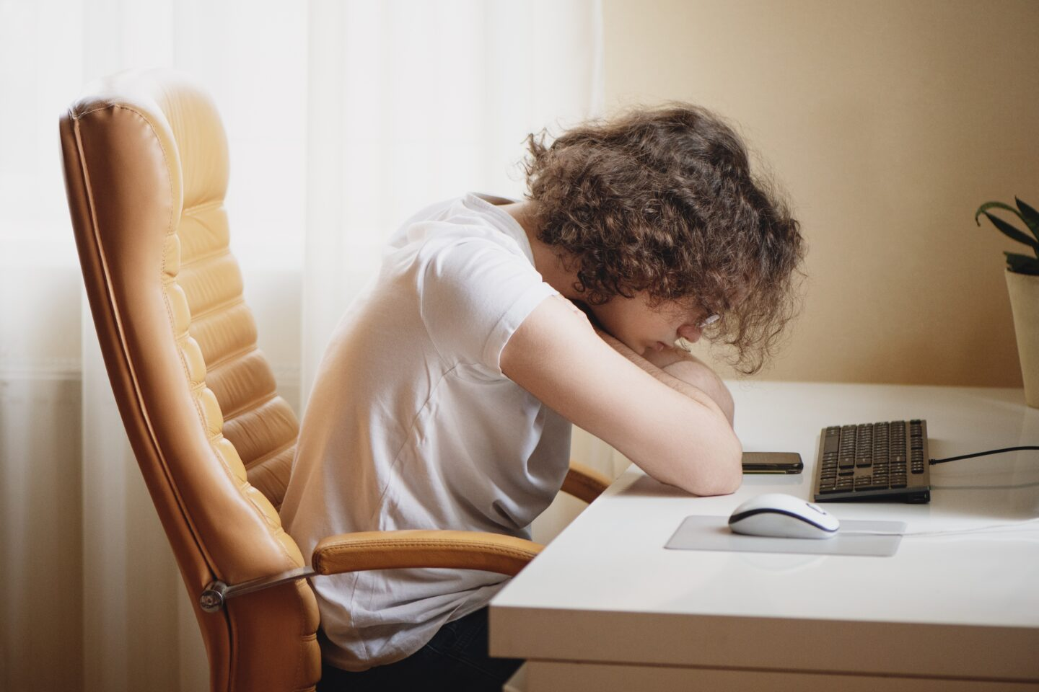
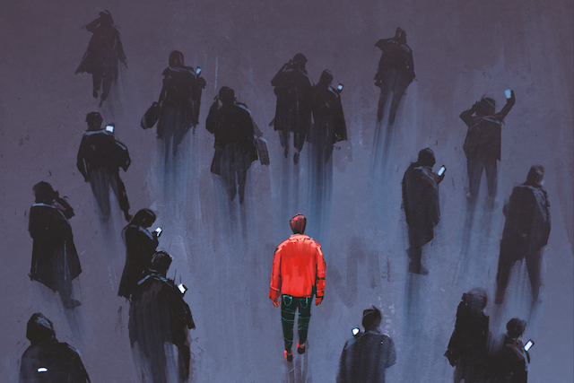
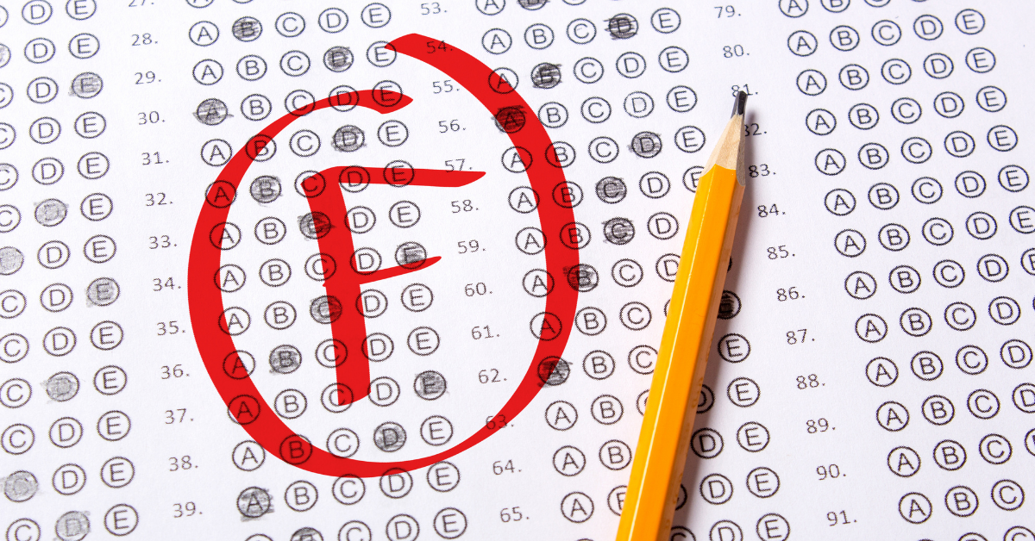
?!
Notes:
Her grades have been dropping and she wishes she had a support system to talk to about her stress.

Slide 5

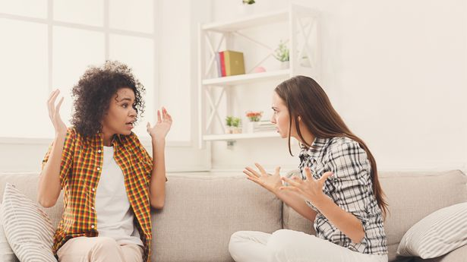
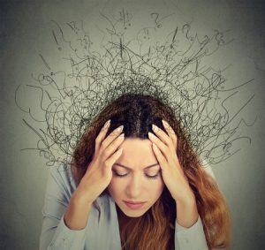
Notes:
She’s tried talking to her friends about it but they don’t understand as they’ve never been in her situation.

Slide 6
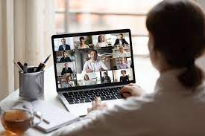
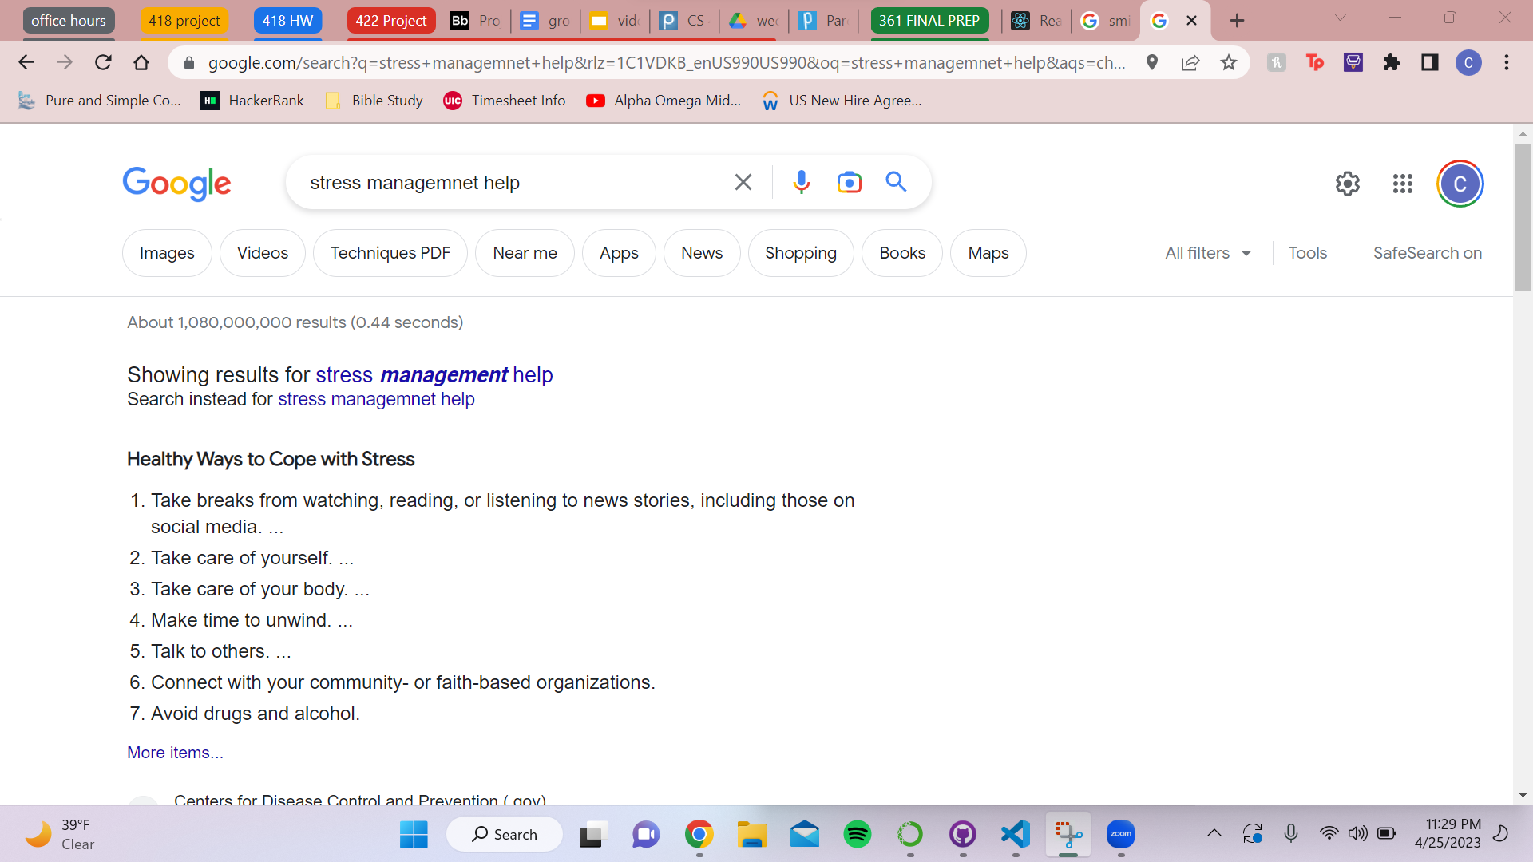
Notes:
She stumbled online and saw Caraway - a therapy app made for female students.

Slide 7
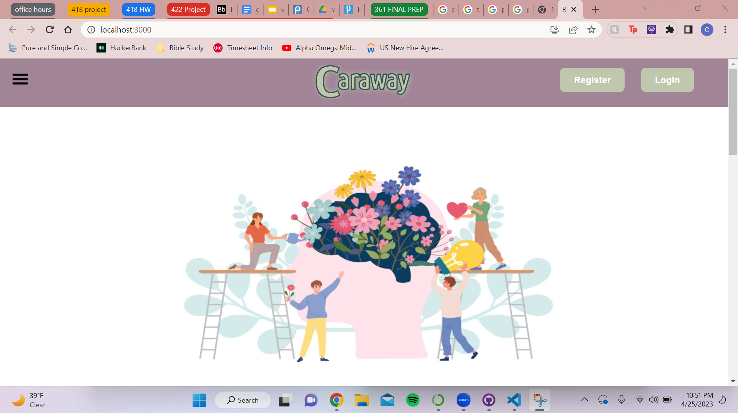
Notes:
She stumbled online and saw Caraway - a therapy app made for female students.

Slide 8
Notes:
She stumbled online and saw Caraway - a therapy app made for female students.

Slide 9

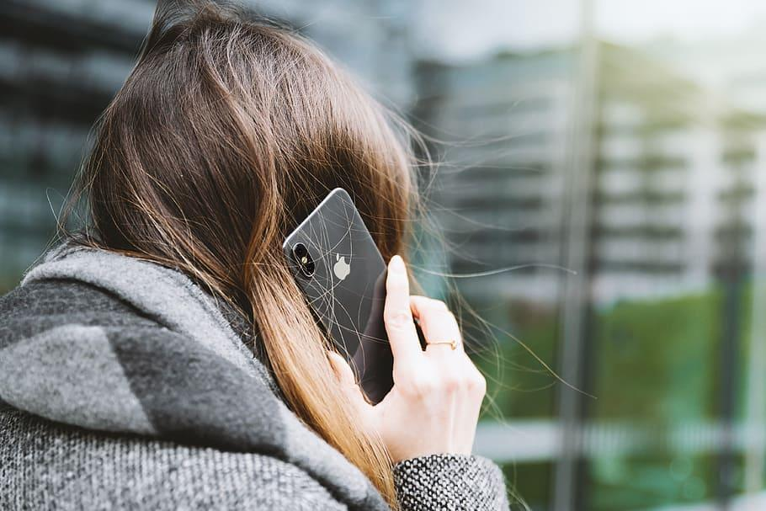

Stress Meter
Notes:
She called in and was able to get approved for he discount

Slide 10
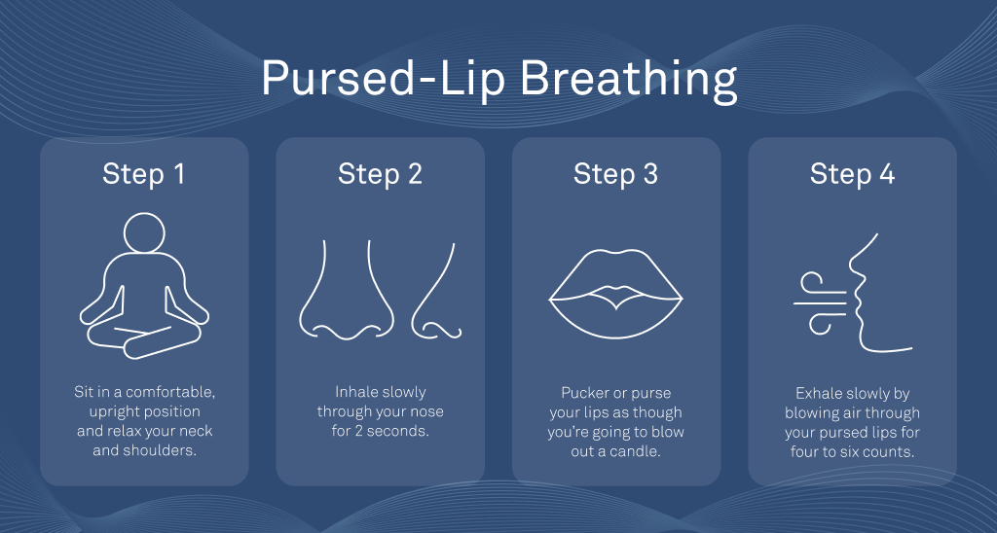
Stress Meter
Notes:
When Jaleesa feels anxious Caraway has breathing and meditation exercises to calm her down.

Slide 11

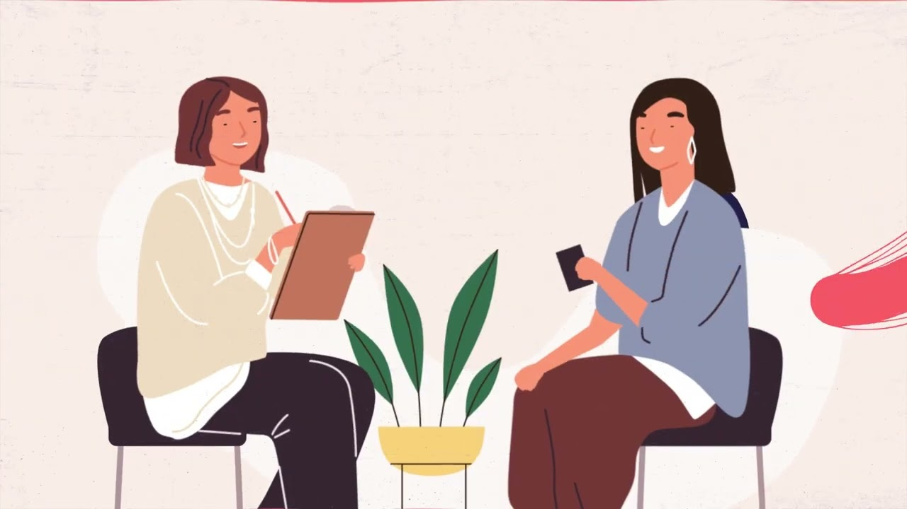
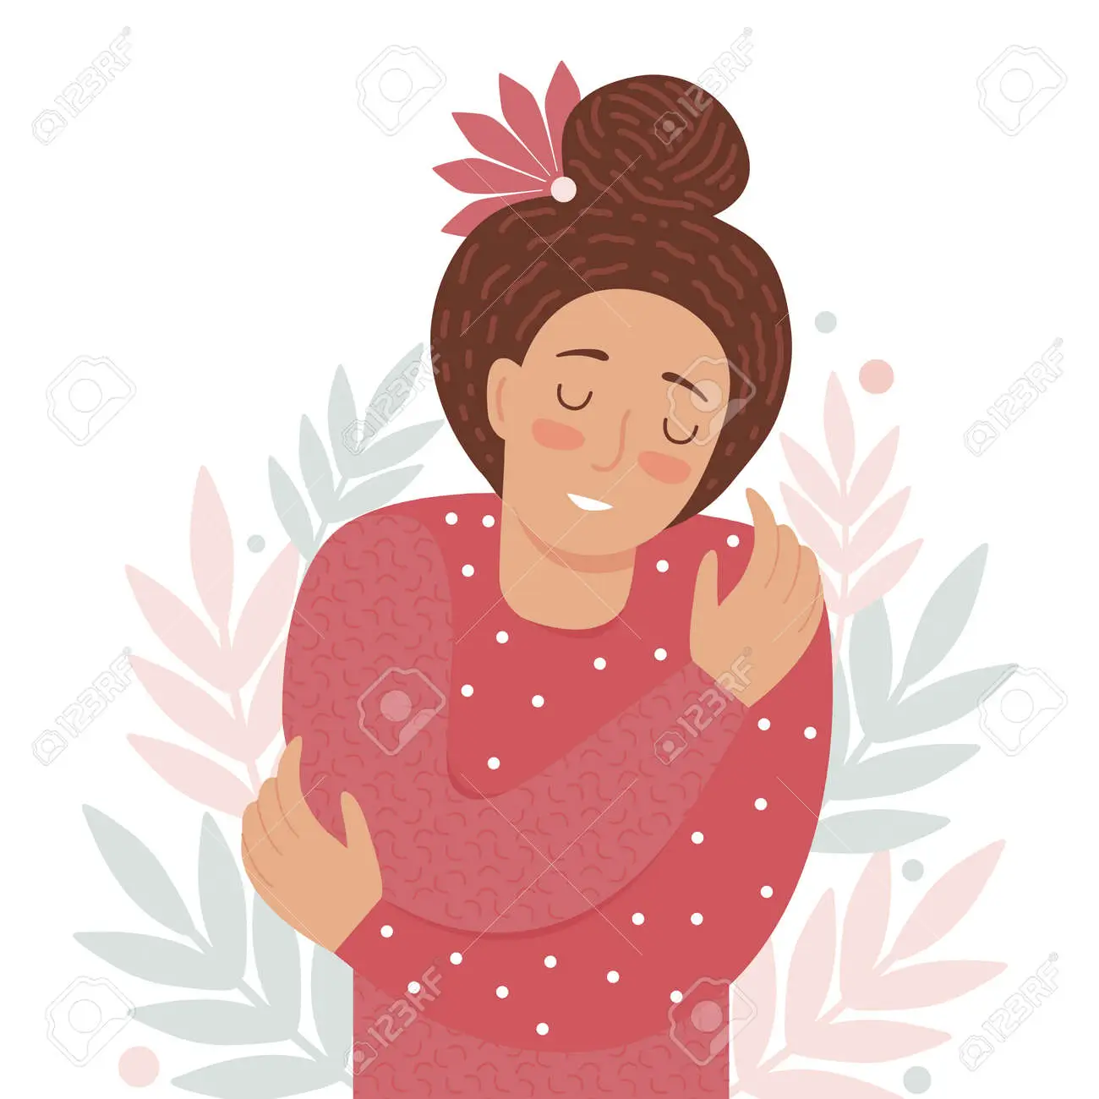
Stress Meter
Notes:
Caraway has made a positive impact on Jaleesas’ overall mental health by giving her a reliable support system she can talk with and find ways to decrease her stress.

